Slide 1

Type 2 Diabetes Mellitus Prediction
Muhammad Faisal Shahid

Slide 2
Overview
Overview of Data
Models Evaluation for T2DM
Another Model..
Future Directions

Slide 3
Our Data
EHR data (2011-2021)
 | Total | Shortlisted (if any) | Reason
Encounters | 5,092,987
Patients* | 1,145,465
Diagnosis Code | 29714
Practices | 738 | 295 | Based on T2DM Diabetics
Vitals | 18 | 9 | Based on Missing Value Ratio (MVR)
Demographics | 3
*Patients selection on next slide

Slide 4
Patients
Total Patients
1,145,465
T2DM Patients
72,626
Other Patients
1,072,839
Patients with at least 3 Encounters
4,896
Other Patients
67,730
Under sampled*
4,896
*Under sampling Criteria is planned to change in Future Work

Slide 5

Preprocessing
Missing data (in vitals)
Threshold >60% (filled with EWMA method)
Class Imbalance
Equal number of Positive and Negative examples

Slide 6
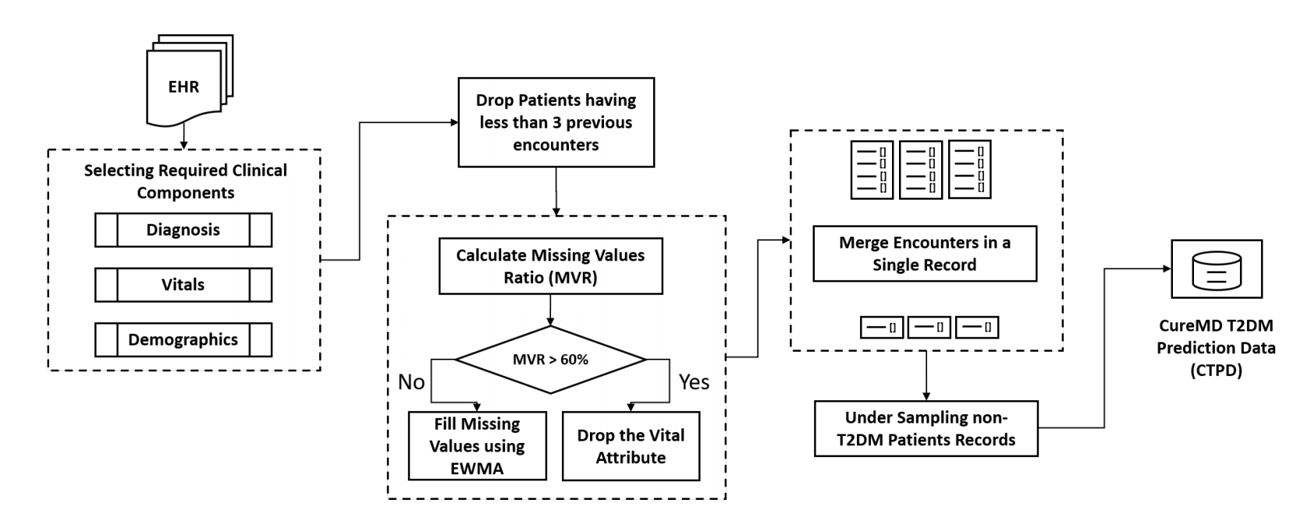
Summary

Slide 7
T2DM Model Evaluation
Algorithm | Accuracy | Precision | Recall | F1 score | AUC
Logistic Regression | 0.876 | 0.881 | 0.868 | 0.875 | 0.876
Random Forest | 0.815 | 0.795 | 0.849 | 0.821 | 0.815
Naïve Bayes (G) | 0.707 | 0.652 | 0.888 | 0.752 | 0.707
KNN | 0.722 | 0.648 | 0.973 | 0.778 | 0.722
SVM (Linear) | 0.876 | 0.878 | 0.873 | 0.875 | 0.876
SVM (Sigmoid) | 0.851 | 0.854 | 0.848 | 0.851 | 0.851
Bagging Classifier | 0.811 | 0.805 | 0.821 | 0.813 | 0.811
AdaBoost (RF) | 0.835 | 0.805 | 0.884 | 0.843 | 0.835
Naïve Bayes (B) | 0.812 | 0.76 | 0.914 | 0.83 | 0.812
Naïve Bayes (M) | 0.806 | 0.75 | 0.919 | 0.826 | 0.806
Decision Tree | 0.774 | 0.779 | 0.771 | 0.773 | 0.774
XGBoost | 0.782 | 0.788 | 0.772 | 0.78 | 0.782

Slide 8
Future Directions (June 2023)
Add Class Imbalance
Feature Selection
Random Survival Forest
Rules Generation for ensemble methods

Slide 9
Pancreatic Cancer

Slide 10
Patients with Pancreatic Cancer and Diabetes
Total Patients
2,432
Diabetic Patients
229
Other Patients
2,203
Diabetes (first diagnosed)
69
Pancreatic Cancer (first Diagnosed)
84
Simultaneously diagnosed*
76
Under sampled
250
*Assumed that Diabetes diagnosed first
*Results evaluated otherwise

Slide 11
Thank you!

Slide 12
Future Directions (June 2023)
Add Class Imbalance
Feature Selection
Random Survival Forest
Rules Generation for ensemble methods (For Both Models)

